Slide 1

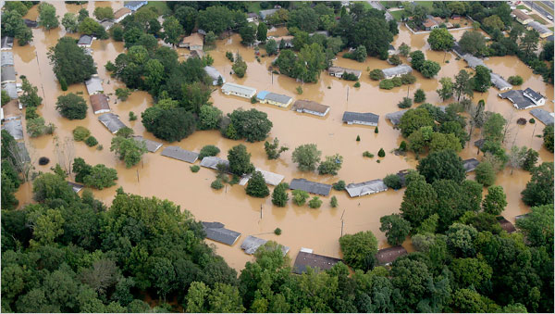


1
2
3
4
5
Q4. ______ means severe flood.
deluge
Score: 30
tide
excess
adamant

